Slide 1




Notes:
*

Slide 2


UI ENGINEERING STUDIO
UI Engineering Studio. Day 9 Bootcamp: React

Slide 3

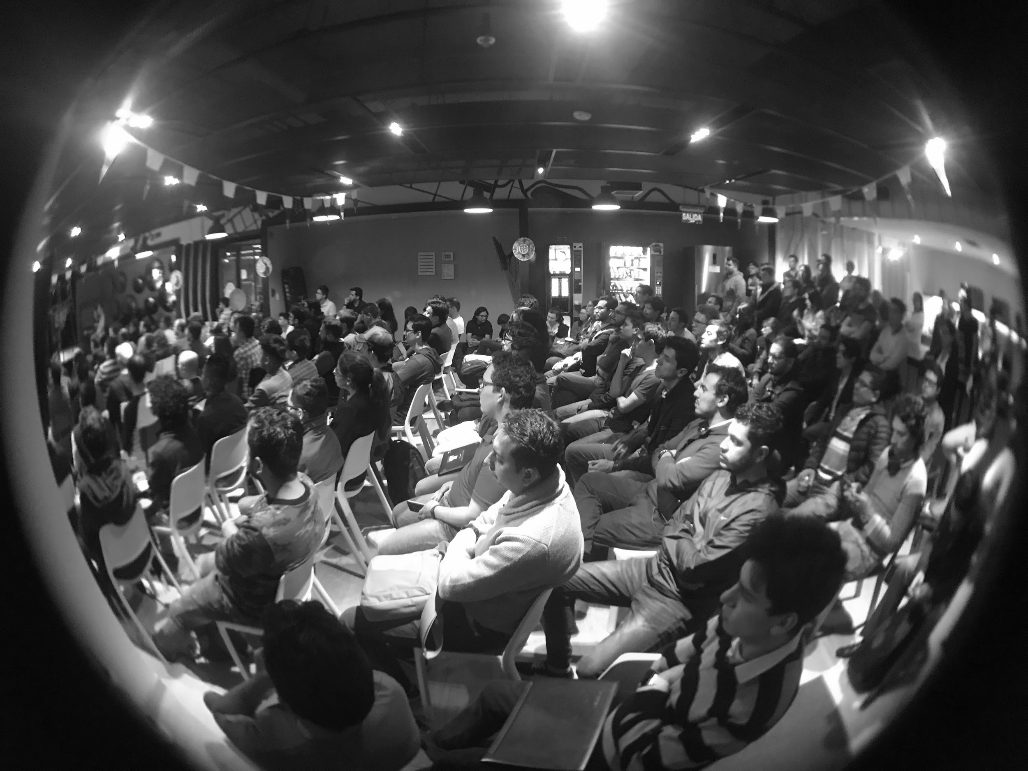
UI ENGINEERING STUDIO
React
is a declarative, efficient, and flexible JavaScript library for building user interfaces. It lets you compose complex UIs from small and isolated pieces of code called “components”
- https://reactjs.org
Why React?
Components
Virtual DOM
JSX
Create React App

Slide 4
UI ENGINEERING STUDIO
UI Boot Camp: React Why React?
Simple
It doesn’t use templates
You can build large applications with a lot of data that changes over the time
It is just JS
Learning curve

Slide 5
UI ENGINEERING STUDIO
UI Boot Camp: React Components
Return a React element to be rendered to the page.
A collection of HTML, CSS, JS and some specific internal data.
Inheritance
Components can be defined using pure Javascript or React’s JSX
Notes:
React components are small, reusable pieces of code that return a React element to be rendered to the page.
A collection of HTML, CSS, JS and some specific internal data which works as a functional modular section of code that can be reusable throughout our app.
Components can inherit data from parent components.

Slide 6
UI ENGINEERING STUDIO
UI Boot Camp: React Identifying Components
https://reactjs.org/docs/thinking-in-react.html
Notes:
React components are small, reusable pieces of code that return a React element to be rendered to the page.
A collection of HTML, CSS, JS and some specific internal data which works as a functional modular section of code that can be reusable throughout our app.
Components can inherit data from parent components.

Slide 7
UI ENGINEERING STUDIO
UI Boot Camp: React Components
https://codepen.io/sebas_alarcon/pen/KeegLa

Slide 8
UI ENGINEERING STUDIO
UI Boot Camp: React Virtual DOM
Create lightweight description of UI components
Representation of a UI is kept in memory and synced with the “real” DOM
Diff between states
Compute minimal set of changes to apply to the DOM
Different to Shadow DOM!
Notes:
Qué es el DOM? El DOM es la estructura de objetos que genera el navegador cuando se carga un documento.
Crea una descripción ligera de los componentes UI
Representación de la UI guardada en memoria y actualizada con el Real DOM
Diferencia entre estados
Calcula la menor cantidad de cambios para aplicar al DOM
Diferente al Shadow DOM

Slide 9
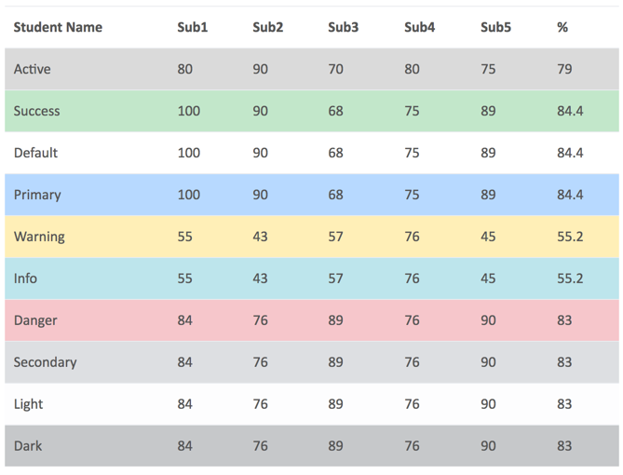
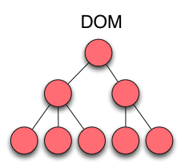
UI ENGINEERING STUDIO
UI Boot Camp: React Virtual DOM

Slide 10
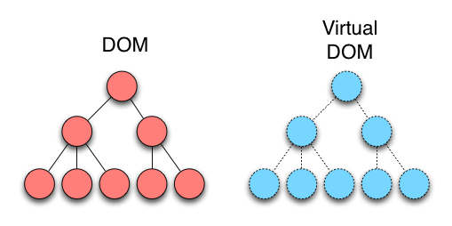
UI ENGINEERING STUDIO
UI Boot Camp: React Virtual DOM

Slide 11
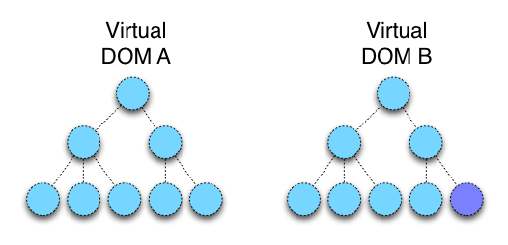
UI ENGINEERING STUDIO
UI Boot Camp: React Virtual DOM

Slide 12
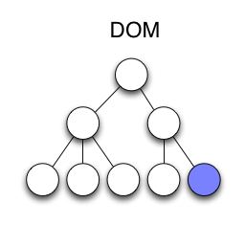
UI ENGINEERING STUDIO
UI Boot Camp: React Virtual DOM

Slide 13
UI ENGINEERING STUDIO
UI Boot Camp: React Virtual DOM: Summary
The entire virtual DOM gets updated.
The virtual DOM gets compared to what it looked like before you updated it. React figures out which objects have changed.
The changed objects, and the changed objects only, get updated on the real DOM.
Notes:
El DOM virtual se actualiza
El DOM virtual se compara con el estado anterior y encuentra cuáles nodos cambiaron
Los objetos cambiados únicamente son actualizados en el real DOM

Slide 14
UI ENGINEERING STUDIO
UI Boot Camp: React JSX: JAVASCRIPT XML SINTAXIS TRANSFORM
Optional HTML markup
Declarative description of the UI inline in JS Code
Combine ease-of-use of templates with power of Javascript
Processor translates to plain Javascript

Slide 15
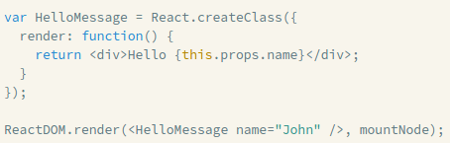
UI ENGINEERING STUDIO
UI Boot Camp: React JSX: JAVASCRIPT XML SINTAXIS TRANSFORM

Slide 16
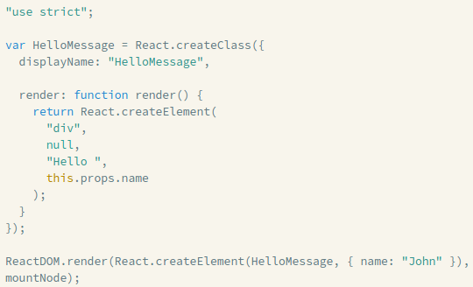
UI ENGINEERING STUDIO
UI Boot Camp: React JSX: JAVASCRIPT XML SINTAXIS TRANSFORM

Slide 17
UI ENGINEERING STUDIO
UI Boot Camp: React Create React App
Is a tool built by developers at Facebook to help you build React applications. It saves you from time-consuming setup and configuration. You simply run one command and create react app sets up the tools you need to start your React project.

Slide 18
UI ENGINEERING STUDIO
UI Boot Camp: React Create React App
You must have: npm +5
And then run:
npx create-react-app my-app

Slide 19
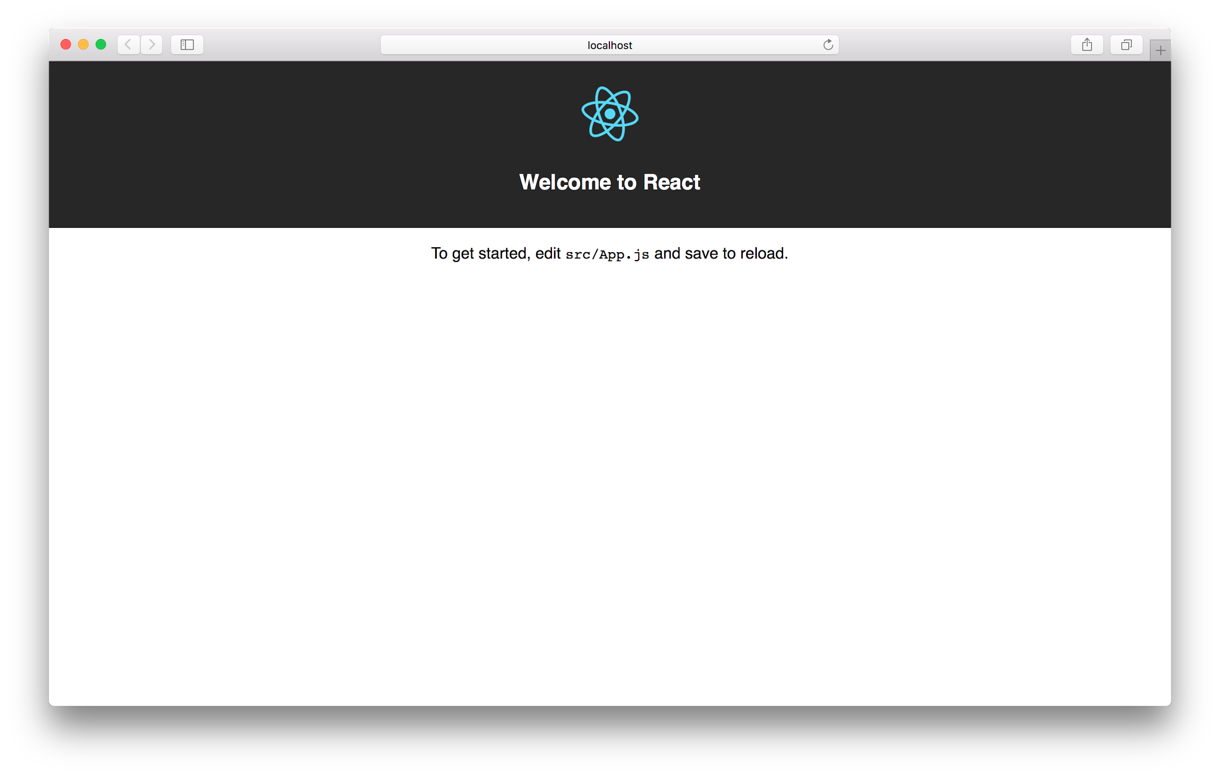
UI ENGINEERING STUDIO
UI Boot Camp: React Create React App

Slide 20

UI ENGINEERING STUDIO
UI Boot Camp: React Homework!
We’re going to start a TODO list.
Think about which components you will need
Code all your stateless components

Slide 21
Notes:
*

